Slide 1
CNOS PROJECT
Computer Network for Exclusive Residence
Students:
Covrig Angelica-Larisa
Paramanov Diana-Alexandra
Coordinators:
Conf. Dr. Ing. Luminița Scripcariu
Şef l. dr.ing. Petre D. Mătăsaru

Slide 2
Presentation of the complex
Visio space sketch
IP Address Analysis
Cisco Packet TRACER implementation
Estimated costs and staff resources

Slide 3
General Presentation
Name of the project: Computer Network for Exclusive Residence
Project location: Municipality Iasi, Iasi County, Street Petre Andrei
Project beneficiary: PEG CONSTRUCT
Entity in charge with project implementation: SC -DLCN- SRL
Project objectives: The objective is designing, implementing and administering the computer networks in the residential complex Exclusive Residence.
Target areas and/or groups aimed: The target group addressed by the implementation of this project is represented by the inhabitants of the complex, agencies or companies operating in the compound, staff members of the residential units.
Project justification: Implementing a computer network for the entire complex will benefit by cutting back on costs and allowing for efficient use of resources, access of data from any device.
Time interval: Start date of the project: 28.03.2020
Date of project completion: 30.05.2020
Estimated total cost of the project: 758,620.27 RON

Slide 4
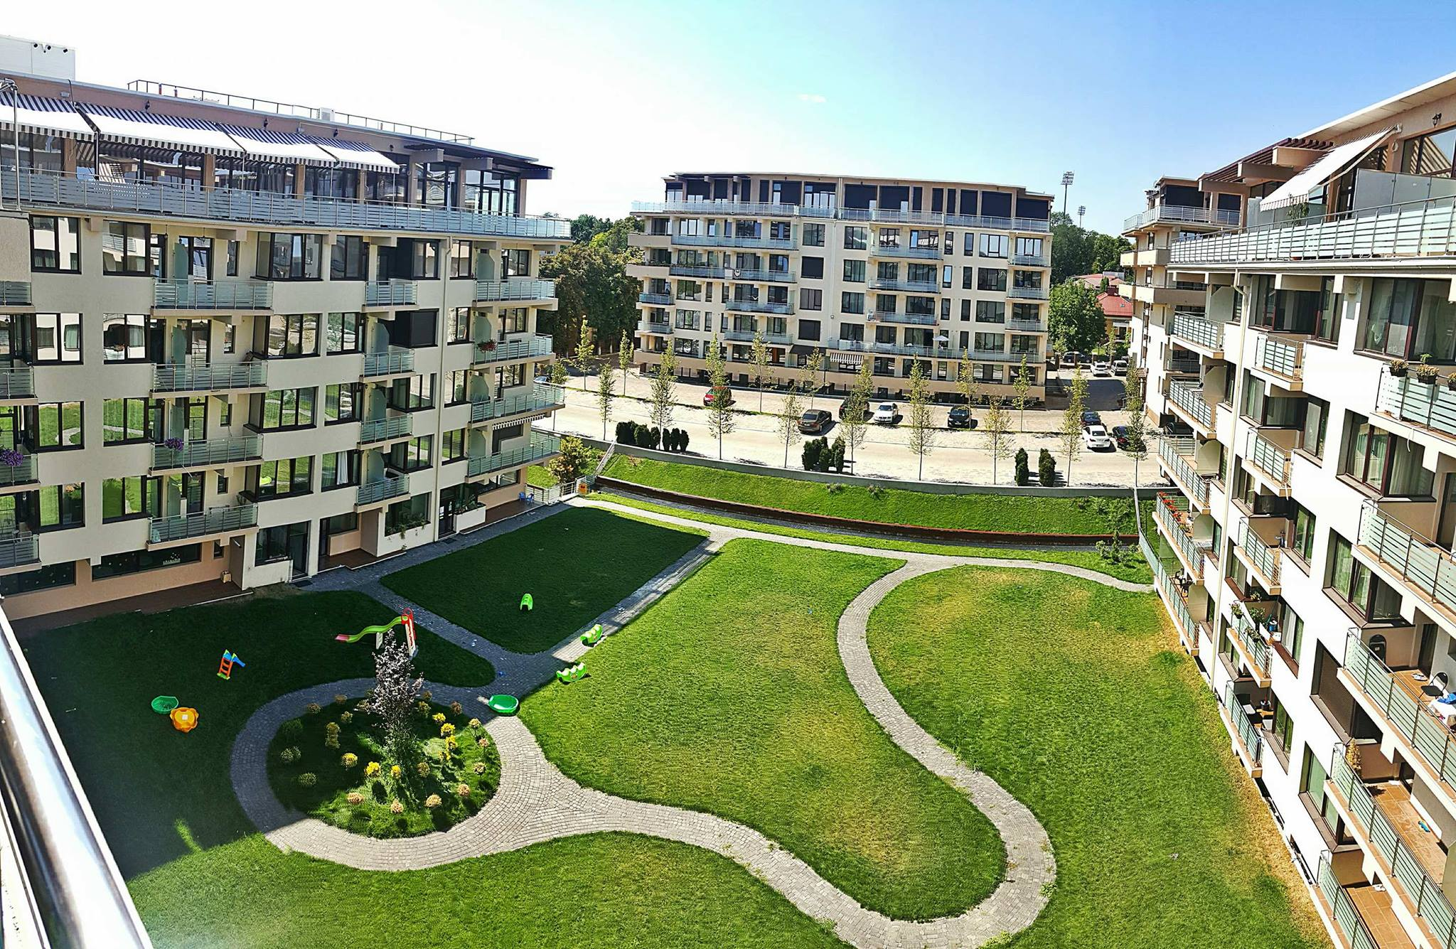
Details about the complex
The complex Exclusive Residence is located in Iasi county on Petre Andrei Street.
It incorporates:
10 apartment blocks
1 security block
1 administrative office
5 commercial premises
leisure areas
1 kindergarten
Each block has 5 floors and
contains 30 flats as follows:
5 1-room flats
15 2-room flats
10 3-room flats
In the current year, 2020,
421 people live in the complex.
The staff of the complex
consists of:
2 administrators
1 secretary
4 security guards
5 cleaning ladies

Slide 5
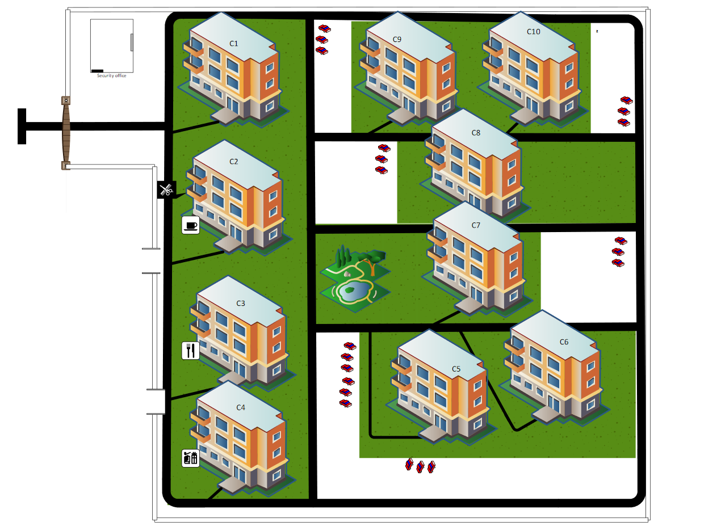
General Layout of the Complex

Slide 6
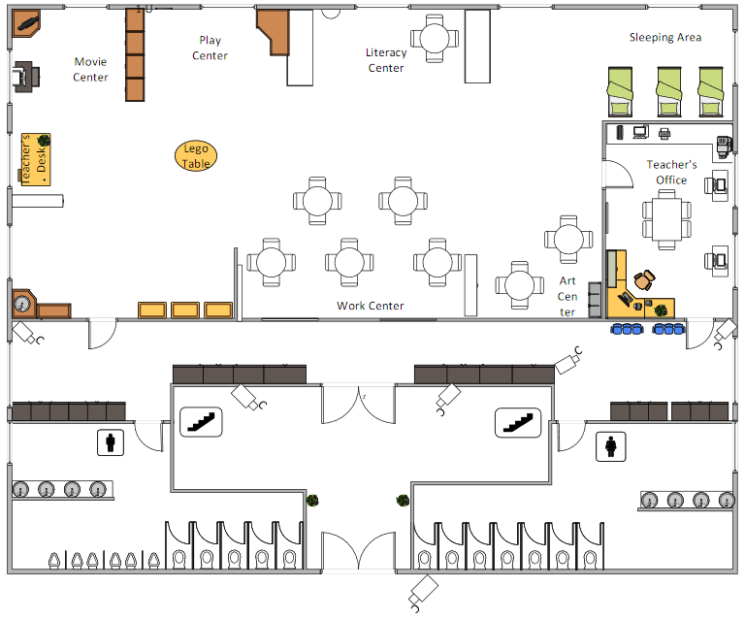
Kindergarten

Slide 7
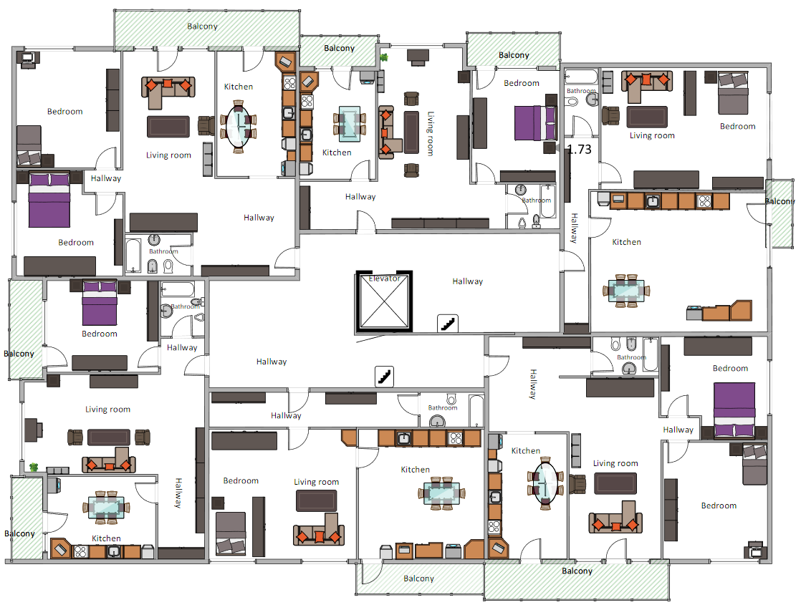
Apartment Block

Slide 8
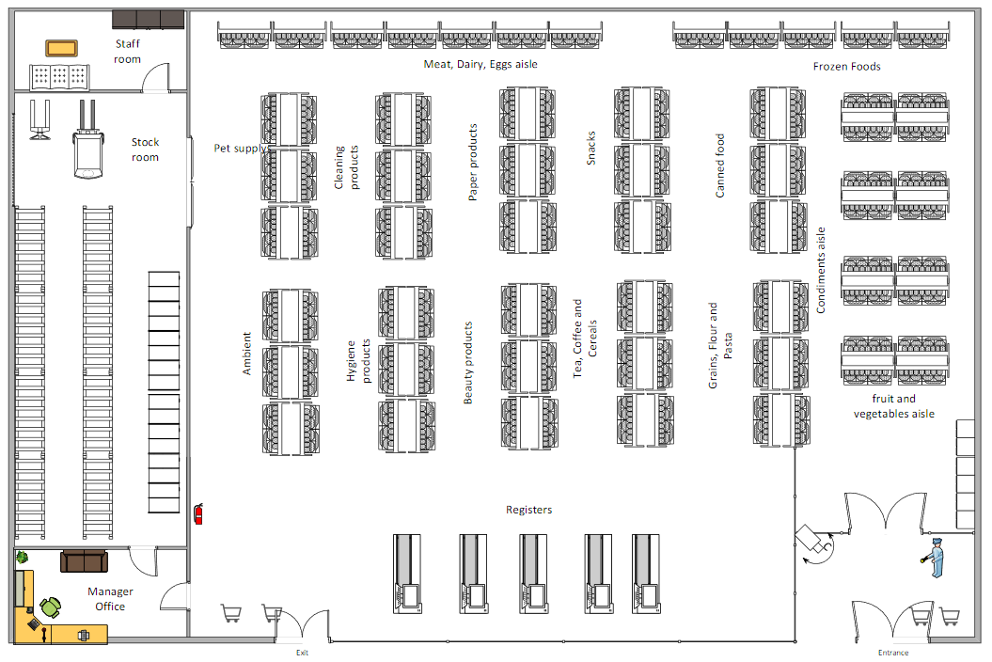
Hypermarket

Slide 9
IP ADDRESS ANALYSIS
IP address block’s class: B
15 subnetworks
Maximum number of hosts per subnetwork is 350
Estimated future number of subnetworks:
18 subnetworks → 2^{S}>=18 →S=5 bits (2⁵=32)
Number of host bits:
2¹¹-2 = 2046 hosts/subnet → H=11 bits
Subnet mask: 255. 255.248.0
CIDR:/21

Slide 10
Subnet | IP Address of the Subnet | Usable Host Range | Broadcast Address
#0 | 152.166.0.0 | 152.166.0.1 - 152.166.7.254 | 152.166.7.255
#1 | 152.166.8.0 | 152.166.8.1 - 152.166.15.254 | 152.166.15.255
#2 | 152.166.16.0 | 152.166.16.1 - 152.166.23.254 | 152.166.23.255
#3 | 152.166.24.0 | 152.166.24.1 - 152.166.31.254 | 152.166.31.255
#4 | 152.166.32.0 | 152.166.32.1 - 152.166.39.254 | 152.166.39.255
#5 | 152.166.40.0 | 152.166.40.1 - 152.166.47.254 | 152.166.47.255
#6 | 152.166.48.0 | 152.166.48.1 - 152.166.55.254 | 152.166.55.255
#7 | 152.166.56.0 | 152.166.56.1 - 152.166.63.254 | 152.166.63.255
#8 | 152.166.64.0 | 152.166.64.1 - 152.166.71.254 | 152.166.71.255
#9 | 152.166.72.0 | 152.166.72.1 - 152.166.79.254 | 152.166.79.255
#10 | 152.166.80.0 | 152.166.80.1 - 152.166.87.254 | 152.166.87.255
#11 | 152.166.88.0 | 152.166.88.1 - 152.166.95.254 | 152.166.95.255
#12 | 152.166.96.0 | 152.166.96.1 - 152.166.103.254 | 152.166.103.255
#13 | 152.166.104.0 | 152.166.104.1 - 152.166.111.254 | 152.166.111.255
#14 | 152.166.112.0 | 152.166.112.1 - 152.166.119.254 | 152.166.119.255
#15 | 152.166.120.0 | 152.166.120.1 - 152.166.127.254 | 152.166.127.255
#16 | 152.166.128.0 | 152.166.128.1 - 152.166.135.254 | 152.166.135.255
#17 | 152.166.136.0 | 152.166.136.1 - 152.166.143.254 | 152.166.143.255
#18 | 152.166.144.0 | 152.166.144.1 - 152.166.151.254 | 152.166.151.255

Slide 11
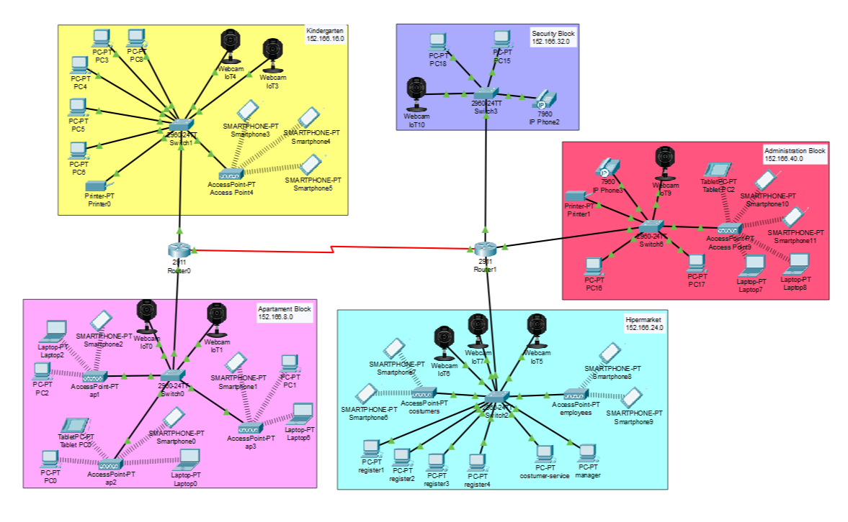
Network Simulation Scheme

Slide 12
Costs of the used material
Equipment | Details | Number of Units | Price per Unit | Total Price (RON)
Cisco Catalyst 2960-24TT - switch | Catalyst 2960 24 10/100 + 2 1000BT LAN Base Image | 14 | 1141.54 | 15981.56
CISCO2911/K9 Cisco 2911 Router ISR G2 | Cisco 2911 router w/3 GE,4 EHWIC,2 DSP,1 SM,256MB CF,512MB DRAM,IPB | 5 | 7572.08 | 37860.4
Access Point Wireless TP-LINK EAP115 | N 300 Mbps, Fast Ethernet | 354 | 158.99 | 56282.46
Cisco CAB-SS-V35MT(Serial DTE) 50 Meter | Access Point Wireless TP-Link EAP115-Wall N 300Mbps PoE IEEE 802.3af 2 Antene Interne eap115-wall | 4 | 1469.66 | 5878.64
Digitus 19'' CAT5e patch panel 48-port | _ | 354 | 170 | 60180
WireRun Rubber Cable Protectors 100 Meters | _ | 10 | 1266 | 12660
4.5" Rack Fan - Middle Atlantic | smooth, ball-bearing design, < 30 dBA; includes hardware | 5 | 176.3 | 881.5
EverFocus® EHD Series Outdoor Camera | 1/3 "CCD color sensor, a resolution of 560 TV lines, a 3.7-12 mm farifocal lens, a smoky case and a 12 VDC power supply | 40 | 430 | 17200
Wall Mount Rack | _ | 5 | 102 | 510
Cable UTP CAT 6 OUTDOOR 1000 METERS | _ | 130 | 2250 | 292,500
Surge protection for mains cable USP201E | _ | 50 | 88.9 | 4445
Dual internet socket Livolo | _ | 354 | 36.1 | 12779.4
 |  |  | TOTAL: | 517,919.26 RON

Slide 13
Logistics Costs
Equipments | Number of Units | Price per Unit (RON) | Total Price (RON)
Laptop Asus X509FA-EJ767 | 3 | 2400 | 7200
Ford TRANSIT 8 EUROPALETI | 1 | 55684 | 55684
Cable tester | 4 | 124 | 496
Wire Strippers
Pair of pliers | 4 | 40 | 160
Wall plug | 400 | 0.5 | 200
Hammer drill | 2 | 311 | 622
Masonry drill bits (box of 20) | 4 | 84 | 336
Regular drill bits (box of 20) | 4 | 76 | 304
Masonry screw (box of 50) | 2 | 71 | 142
Utility knife | 6 | 6 | 36
Toolbox | 3 | 300 | 900
Ladder | 2 | 420 | 840
Socket | 100 | 5 | 500
Power strip | 50 | 12 | 600
EZ RJ45 and RJ11-12 Plug Connectors 100/pack | 5 | 152.06 | 760.3
Cable stripper | 3 | 70 | 210
Cable tacker staple gun | 1 | 174 | 174
Measuring tape | 3 | 44 | 132
 |  | TOTAL: | 69,296.3 RON

Slide 14
Staff resources
Employed | Gross Salary | Social Insurance(25%) | Health Insurance(10%) | Labor Insurance Contribution(2.25%) | Income Tax(10%) | Net Salary
Senior Network Engineer | 9684 | 2421 | 968 | 218 | 630 | 5665
System Engineer | 6342 | 1586 | 634 | 143 | 412 | 3710
Assembly Engineering Technician | 4260 | 1065 | 426 | 96 | 277 | 2492
Assembly Engineering Technician | 4260 | 1065 | 426 | 96 | 277 | 2492
Assembly Engineering Technician | 4260 | 1065 | 426 | 96 | 277 | 2492
TOTAL: | 57,612 RON
Workmanship:
Estimated time for the project: 2 months/day (5 days/week)
9684 RON x2(months) = 19,368 RON (Senior Network Engineer)
6342 RON x2(months) = 12,684 RON (System Engineer)
4260 RON x2(months) = 8,520 RON/Assembly Engineering Technician
Overall cost: 644,827.56 RON
Total: 758,620.27 RON
Income (15%): 113,792.71 RON

